Slide 1


HandRate: Heart Rate Monitoring While Simply Holding a SmartPhone
Kevin Jiokeng, Gentian Jakllari, André-Luc Beylot IRIT/Toulouse INP-ENSEEIHT, University of Toulouse, France – Email: firstname.lastname@toulouse-inp.fr IEEE PerCom’21 – March 25th, 2021

Slide 2
Context
Heart Rate Monitoring: early identification and prevention of heart diseases
⇒ Multiple medical devices (use at hospital or home)
But Cardiovascular Diseases still remain the world’s leading cause of death [AHA, 2018] → 22M+ in 2030
Notes:
(>22M in 2030)

Slide 3
Context
Existing approaches with a Smartphone:
Adding specialized sensors
-- Not accessible to a wide range of users
Using built-in sensors:
Ordinary camera as a PPG sensor
IMU with phone on the chest or the navel
-- Require active user participation
Sensing
+
Processing power
_____________
Always with us

Slide 4
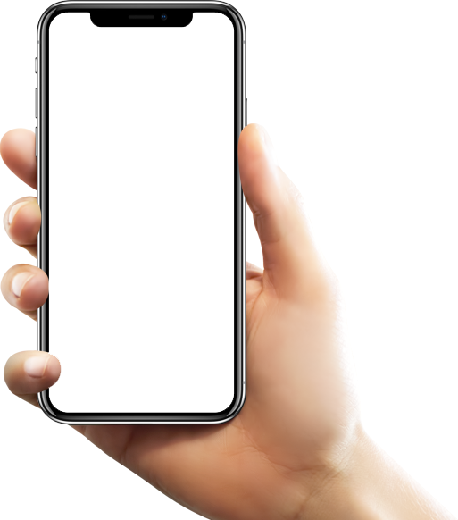
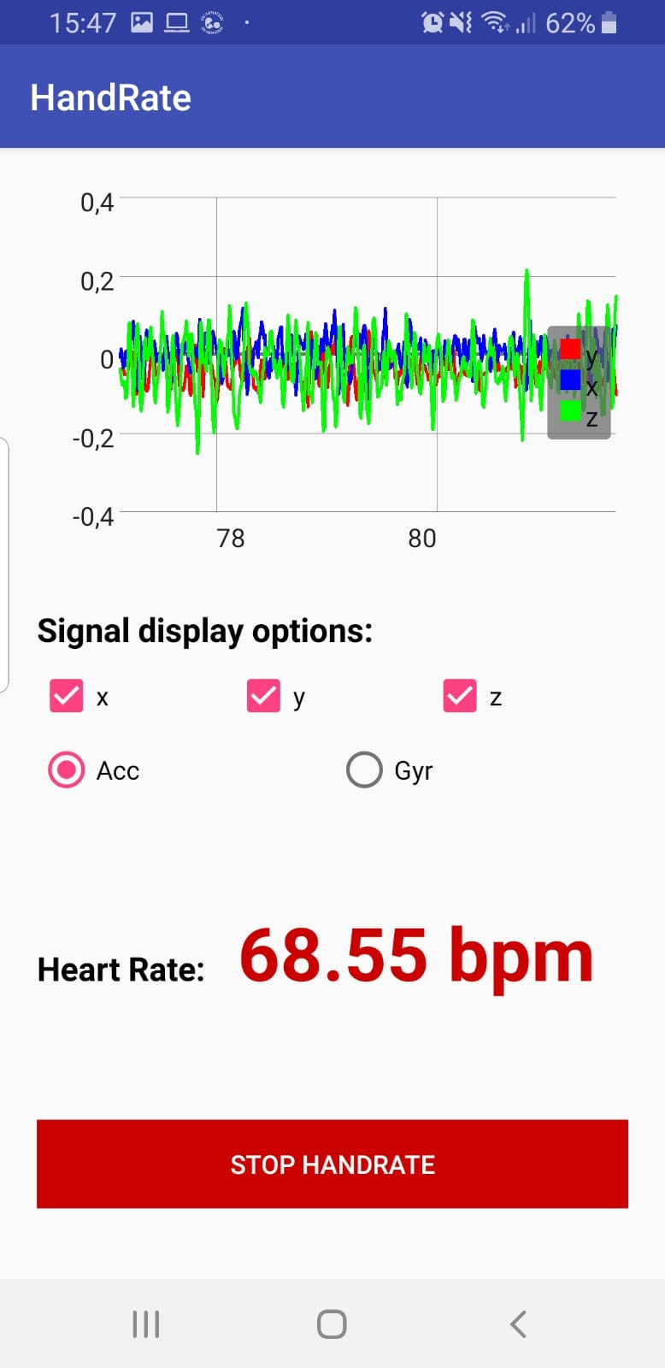
HandRate
Heart Rate Monitoring without active user participation
HandRate revisits Ballistocardiography (BCG)
- Measurement of the body movement during cardic cycle - Caused by recoil forces (espcially during the systole)
Two important questions :
Is it possible to acquire BCG in hand with a commodity mobile phone ? Far away from the heart and subject to motion artifacts
If yes, which system to extract Heart Rate from it ?

Slide 5
Outline
Introduction: Context, Existing approaches and Questions
Hand-BCG: Feasability Study
HandRate: Our System
Performance Evaluation
Conclusion

Slide 6
Hand-BCG: is it possible?
The theoretical answer
Smartphones’ accelerometers are able to sense very weak motions
Typical sensitivity value: 2 x 10⁻³ m.s⁻²
Peaks’ average in our dataset: 9 x 10⁻² m.s⁻²
barely an order of magnitude greater than the accelerometers’ noise level (~2 x 10⁻² m.s⁻²)

Slide 7
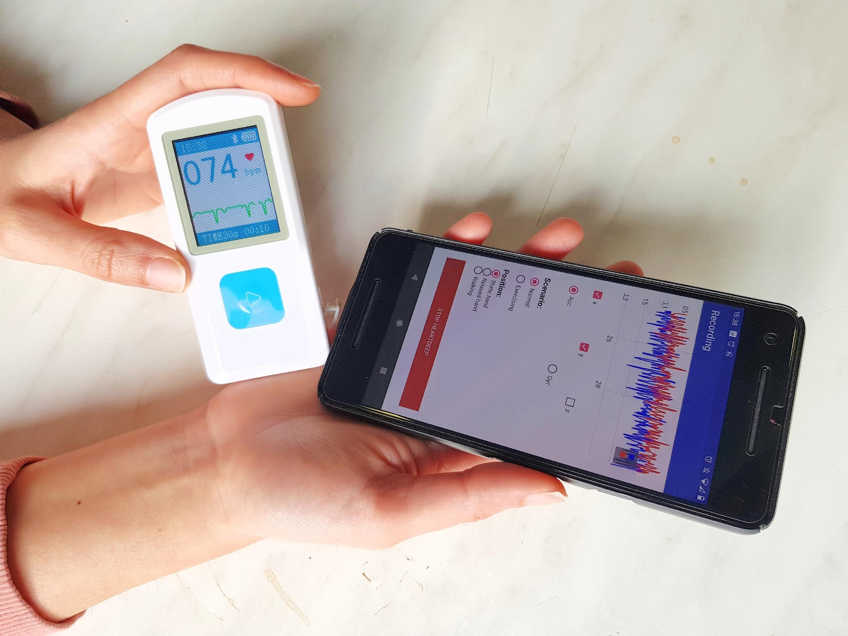
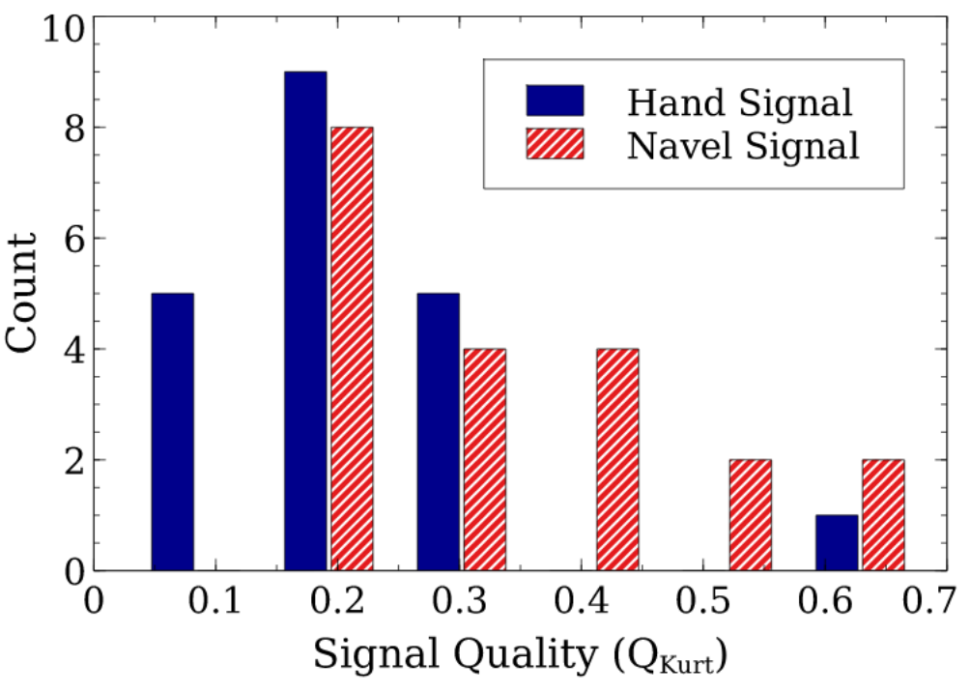
Hand-BCG: is it possible?
Experimental study
Collection of multiple signals: 30s per session
Hand vs Navel (reference)
Frequency domain analysis
Computation of signal quality : Q_{kurt} [1]
[1] R. Mohamed and M. Youssef, “Heartsense: Ubiquitous Accurate Multi-Modal Fusion-based Heart Rate Estimation Using Smartphones” ACM IMWUT, 2017

Slide 8
Hand-BCG: Opportunities and challenges
BCG signal can be sensed from hand using a smartphone’ accelerometer
But this signal can be of poor quality, making Heart Rate computation challenging

Slide 9
Outline
Introduction: Context, Existing approaches and Questions
Hand-BCG: Feasability Study
HandRate: Our System
Performance Evaluation
Conclusion

Slide 10
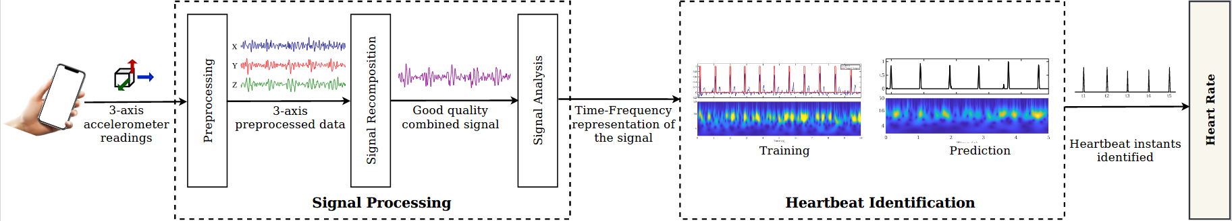
HandRate
Heart Rate Monitoring system with phone in hand
Just takes as input the accelerometer readings to compute the Heart Rate

Slide 11
Preprocessing
--> in the range [-1, 1]
Filtering out too weak or too strong signals
Filtering
Resampling
Normalization
Denoising
--> Fs = 100Hz
Reduce noise
Applied on each of the 3 axes independently

Slide 12
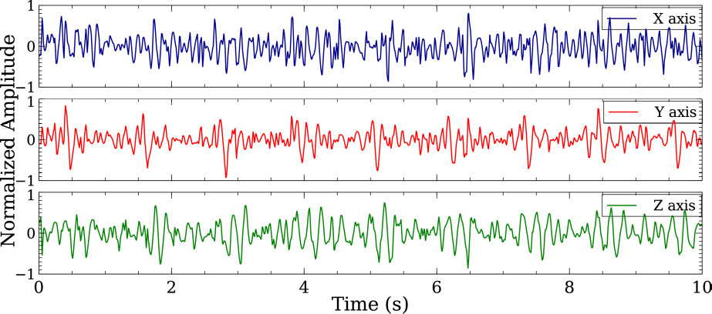
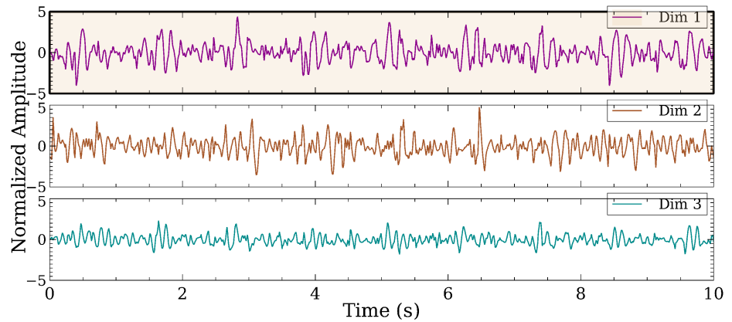
Signal Recomposition
Problem: the axis that best measures the signal depends on how the user holds the phone
Two possible approaches :
Process (each of the axes) + Combine (the results)
Combine (the axes) + Process (the resulting 1D signal)
Choice: Principal Component Analysis

Slide 13
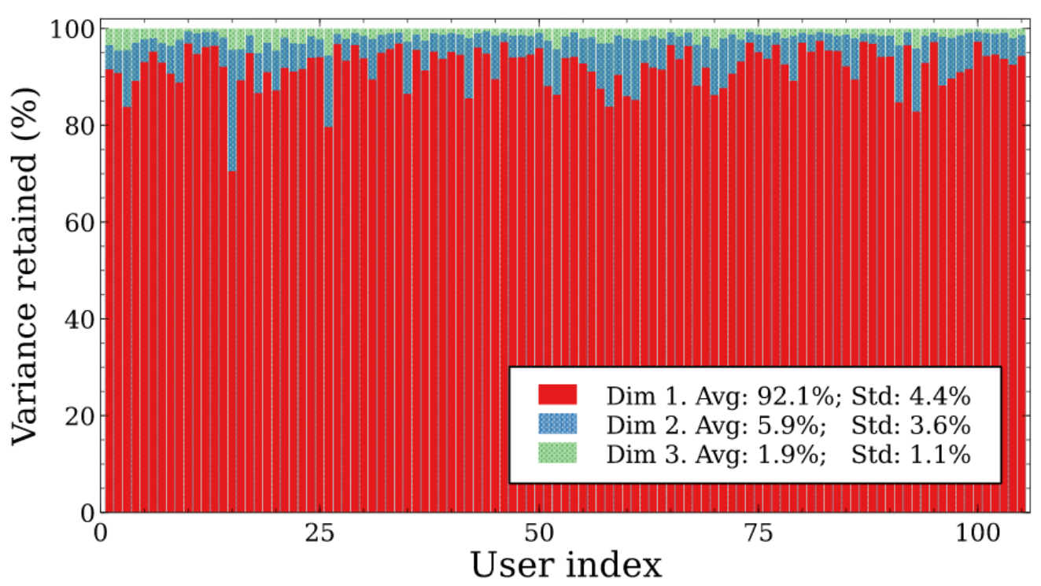
Signal Recomposition
Evaluation
105 volunteers
30s per volonteer
Apply PCA and compute the amount of variance retained on each dimension
92.1% of variance retained on the first PC

Slide 14
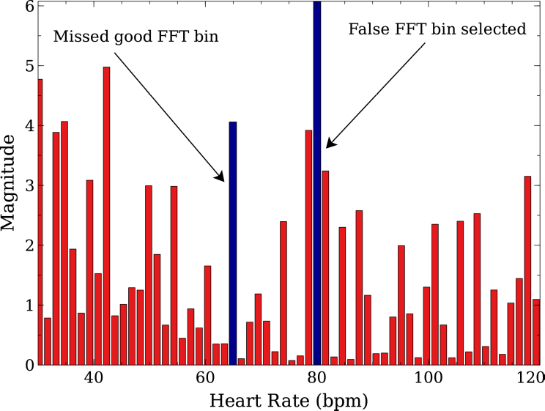
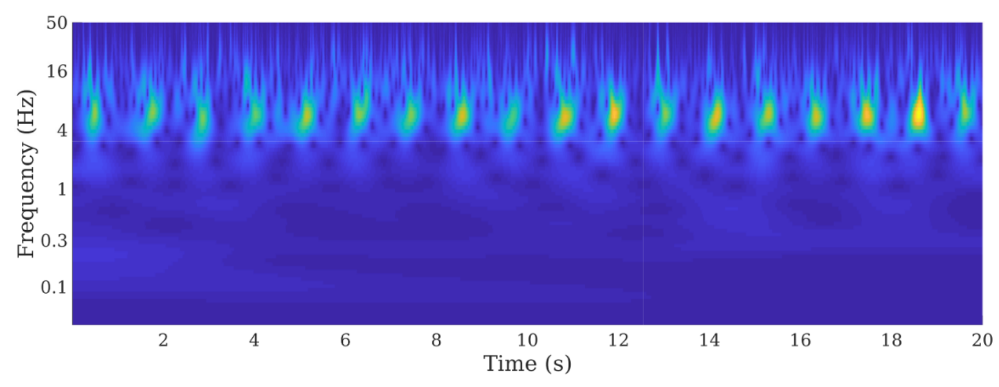
Signal Analysis
Processing options (for the 1D signal):
Purely in the time domain. But not clear peaks
Purely in the frequency domain
Time-frequency approach:
Spectrogram (Short Time Fourier Transform)
Scalogram (Continuous Wavelet Transform) because of events better localized in time

Slide 15
Heartbeat Identification

Slide 16
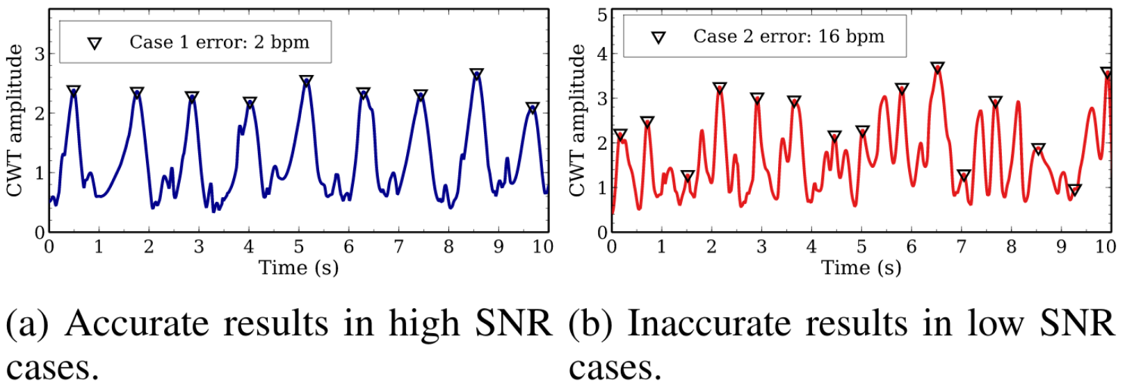
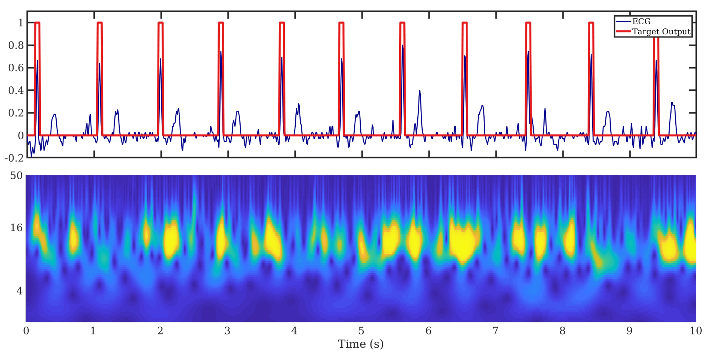
Heartbeat Identification
Straightforward approach: "flatten" the scalogram by taking the maximum value of each timestep
Mixed results (like the quality of the data)
Neural network:
Model capable of predicting the heartbeat instant
Based on the ECG measured at the same time

Slide 17
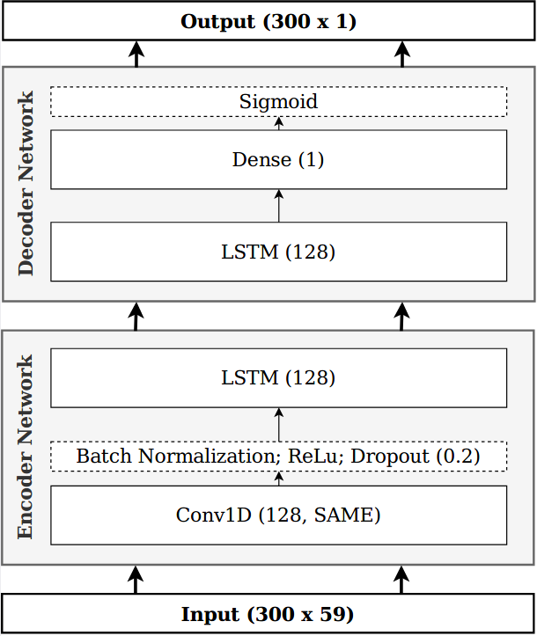
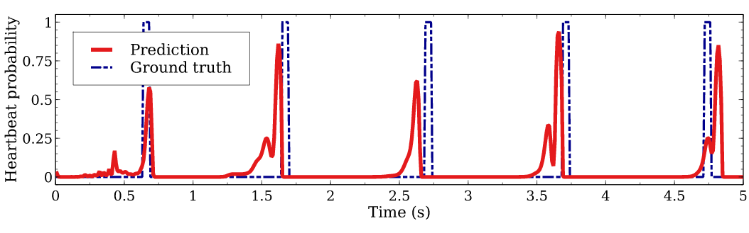
Heartbeat Identification
About the NN model:
Encoder-decoder architecture (seq2seq)
Processing by sliding windows of 3s (2s stride)
Not big model: ~ 236k parameters
Combatting dataset imbalance:
Weighted loss function (greater weight for ‘1’)
Multiple ‘1’ for a single peak

Slide 18
Outline
Introduction: Context, Existing approaches and Questions
Hand-BCG: Feasability Study
HandRate: Our System
Performance Evaluation
Conclusion

Slide 19
Evaluation: Setup
The data:
18 participants, 10+ sessions per person
Fairly varied dataset: covers the range of 54 - 106 bpm
Two versions of HandRate:
general model (HandRate-g)
personalized model (HandRate-p)
Comparison with:
FFT-based: search for the most active freq. in the FFT spectrum
Xcorr-based: cross-correlation between the signal and a template, and taking the peaks
CWT-based: Downsampling of the scalogram and selection of peaks
Other systems (SCG, PPG, special sensors)

Slide 20
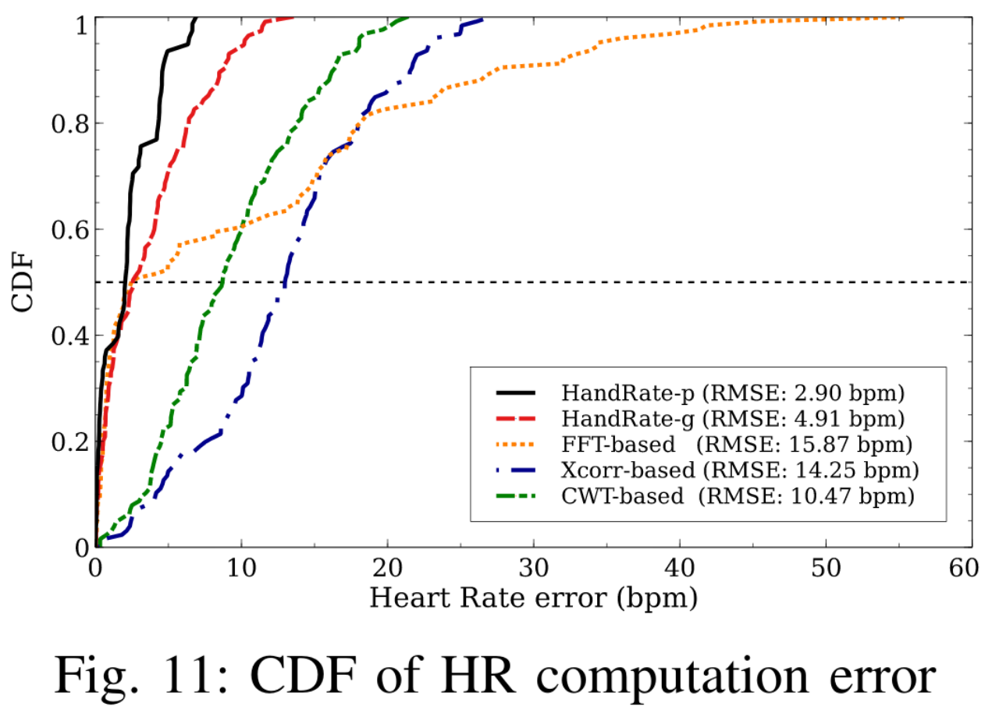
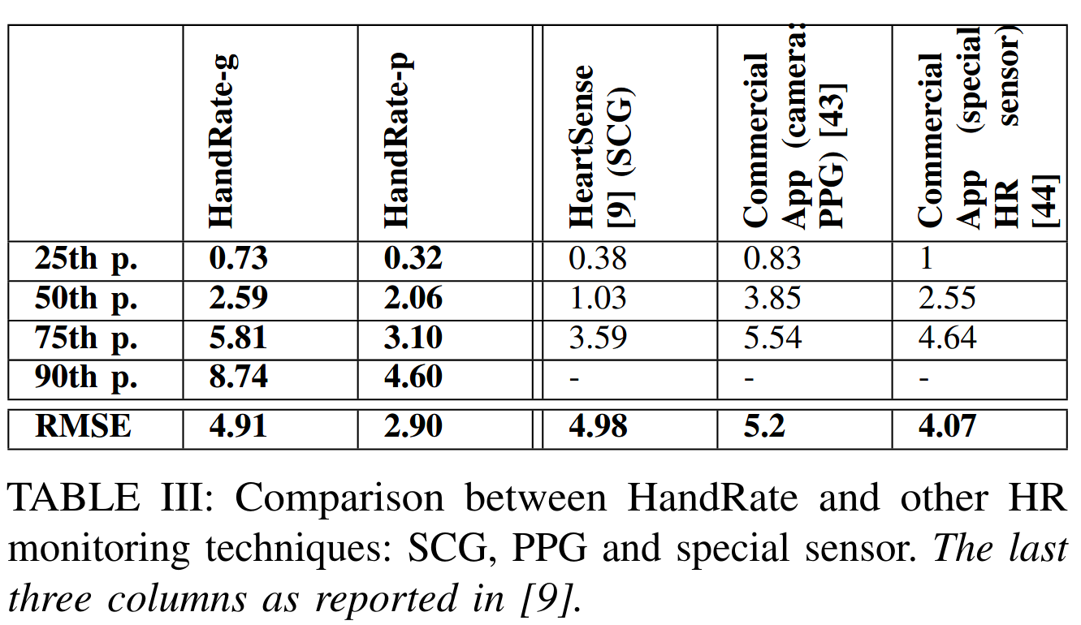
Evaluation: Results
HandRate performs better (median of 2.9 bpm) And HandRate-p even more (median of 2 bpm)
HandRate achieves results comparable to techniques that require special sensors and/or active participation
FFT-based

Slide 21
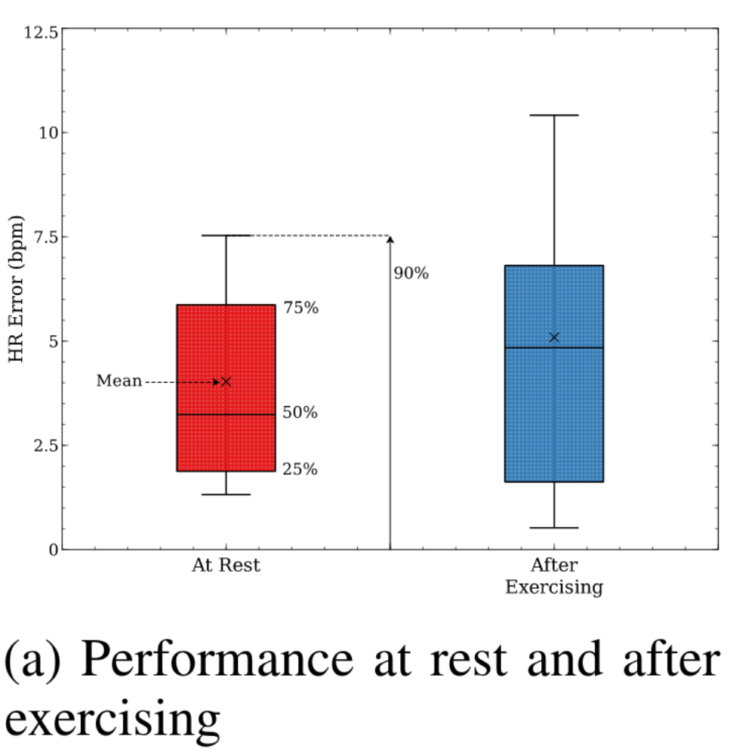
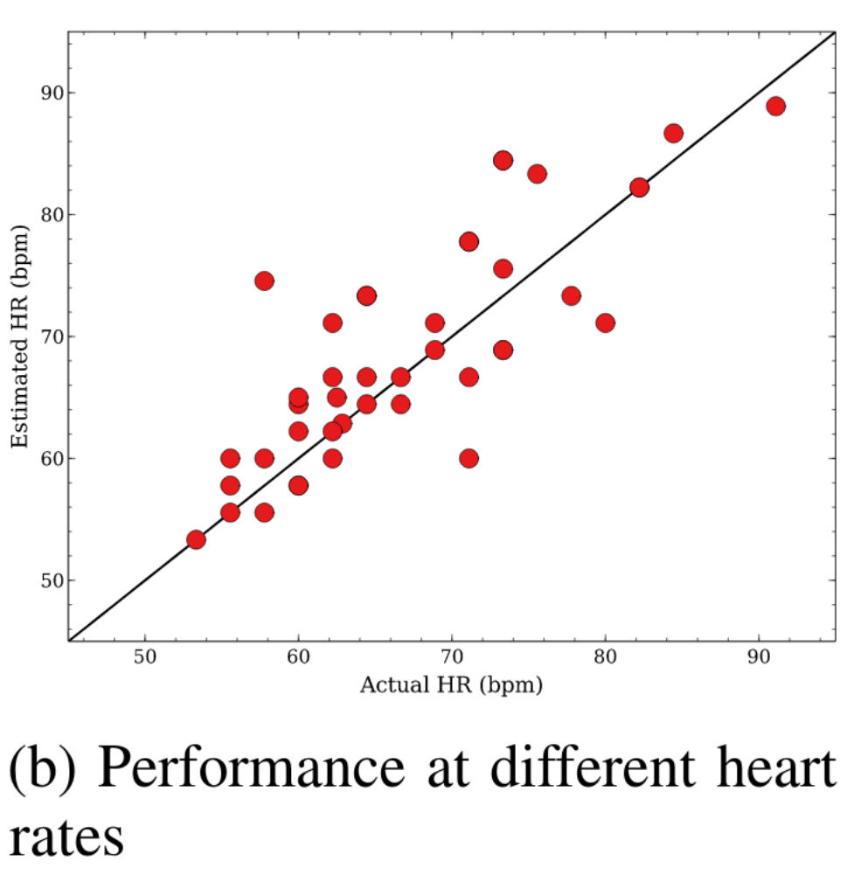
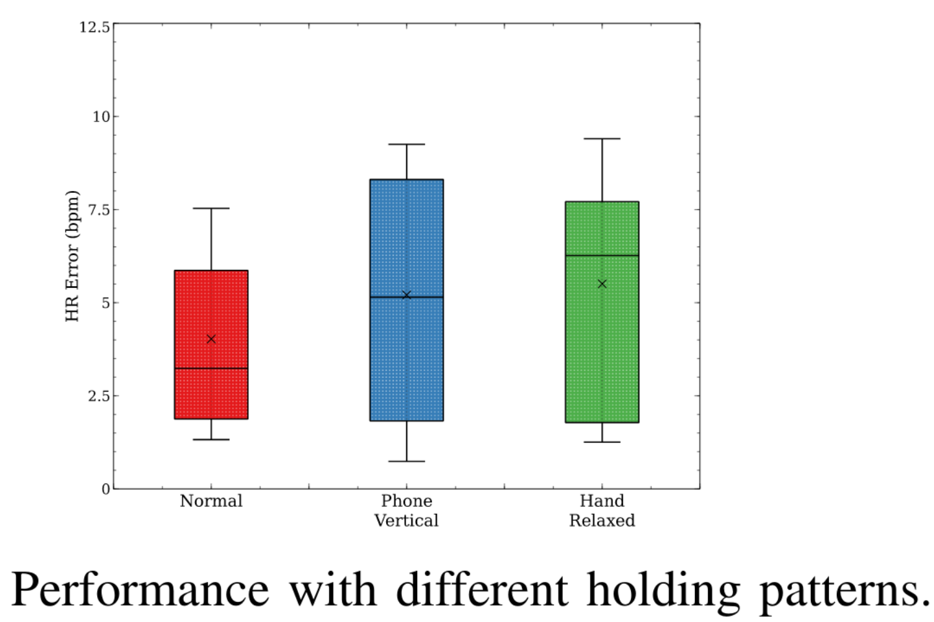
Evaluation: Results
HandRate(-g) performs well in different experimental conditions
And runs in real time (~200ms of processing time every 2 seconds)

Slide 22
Outline
Introduction: Context, Existing approaches and Questions
Hand-BCG: Feasability Study
HandRate: Our System
Performance Evaluation
Conclusion

Slide 23
Conclusion
Heart rate monitoring system with a phone in hand
Feasibility study
Design of a system to perform this task
Performance evaluation - Error comparable to other techniques and performs well under different experimental conditions
Future work
More diverse data collection and evaluation (large period of time in daily life, phone models, non-healthy subjects)

Slide 24
Thank you for your attention.
And for your questions :)

